Slide 1

TECHNICAL ANALYSIS
GAUTAMI
PRANJAL
KAUSTUBH
YASH
GIRISH

Slide 2
Agenda
Introduction
Fundamental Analysis Vs Technical Analysis
Trends
Support and Resistance
Indicators
Technical Analysis implementation
Portfolio Composition

Slide 3
Intro to Technical Analysis
Technical analysis is a trading tool that attempts to forecast the future movement of stocks by analyzing statistics gathered from trading activity; such as price movement and volume
Underlying Assumptions
Market discounts everything
Price moves in trends
History of price movement tends to repeat itself
Inputs
Asset Price
Trading Volume
Outputs
Price Trend Prediction
Notes:
A major criticism of technical analysis is that it only considers price movement, ignoring the fundamental factors of the company. However, technical analysts assume that, at any given time, a stocks price reflects everything that has or could affect the company – including fundamental factors. Technical analysts believe that the companys fundamentals, along with broader economic factors and market psychology, are all priced into the stock, removing the need to actually consider these factors separately. This only leaves the analysis of price movement, which technical theory views as a product of the supply and demand for a particular stock in the market.
Price moves in trends In technical analysis, price movements are believed to follow trends. This means that after a trend has been established, the future price movement is more likely to be in the same direction as the trend than to be against it. Most technical trading strategies are based on this assumption. History tends to repeat itself Another important idea in technical analysis is that history tends to repeat itself, mainly in terms of price movement. The repetitive nature of price movements is attributed to market psychology. In other words, market participants tend to provide a consistent reaction to similar market stimuli over time. Technical analysis uses chart patterns to analyze market movements and understand trends. Although many of these charts have been used for more than 100 years, they are still believed to be relevant because they illustrate patterns in price movements that often repeat themselves

Slide 4
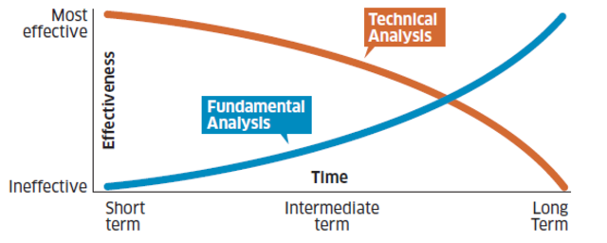
Fundamental Analysis Vs Technical Analysis
Category | Fundamental Analysis | Technical Analysis
Definition | Uses economic factors to calculate stock value | Uses movements in trade price and volume to predict trends
Primary Factors | Financial statements | Charts, stock prices and trading volumes
Time horizon | Long term | Short term
Function | Investing | Trading

Slide 5
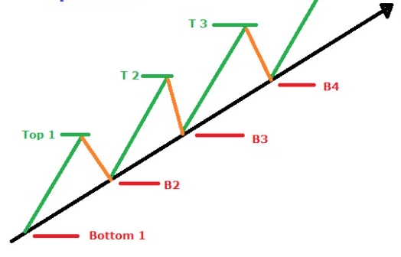
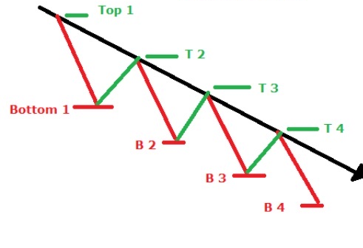
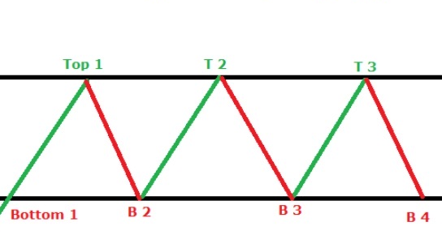
Trends
Upward
Higher highs & higher lows
The second low should be higher than first for having incline
Uptrend line acts as a support and indicates that the demand is greater than the supply
Downward
Lower highs & lower lows
The second high must be lower than first for having decline
Downtrend line acts as a resistance and indicates that supply is more than the demand
Sideways
Constant high, constant lows
Support and resistance lines oscillate
Correction estimation enables traders buy at support and sell at resistance

Slide 6
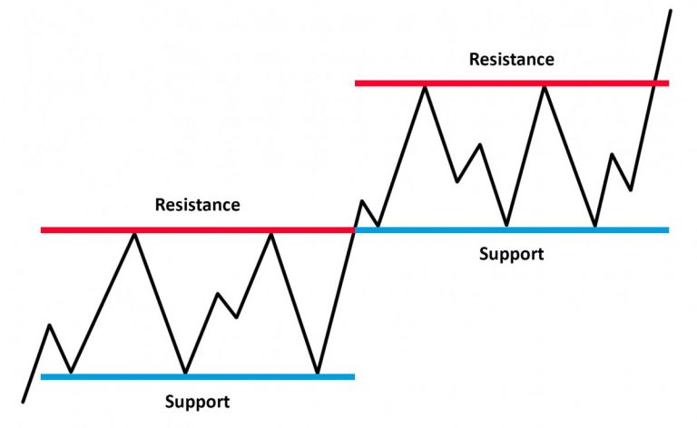
Support & Resistance
Support
Price level at which the demand is thought to be strong enough to prevent price from declining further
Buyer are inclined towards buying as the price grows closer to support
Resistance
Price level at which selling is thought to be strong enough to prevent price from rising further
Sellers become more inclined to sell as the price grows near to resistance
Breakout
Whenever price breaks one of the lines, it becomes the opposite

Slide 7
Indicators
Momentum indicators
Trend indicators
Volatility
RSI
MACD
SMA
EMA
Bollinger bands
RSI : Relative Strength index SMA: Simple Moving Average
EMA: Exponential Moving Average MACD: Moving Average Convergence Divergence

Slide 8
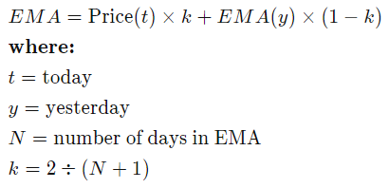
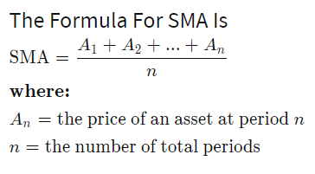

Trend Indicators (SMA & EMA)
Simple Moving Average (SMA)
Average closing price over a given time period. "Moving average" is that once a new data point is available, last data point is dropped
Exponential Moving Average (EMA)
Similar to SMA, however a weight factor is used to assign a higher weight to more recent change
Example: 9 Day EMA
K=2/(9+1) = 0.2
Example: 9-day SMA
(i) 9 5 6 3 8 3 9 5 8 1 4 2 8 2 𝑆𝑀𝐴 = 𝟒. 𝟔𝟕
(ii) 9 5 6 3 8 3 9 5 8 1 4 2 8 2 9 𝑆𝑀𝐴 = 𝟓. 𝟑
(i) 9 5 6 3 8 3 9 5 8 1 4 2 8 2 𝐸𝑀𝐴₀ = 𝑆𝑀𝐴 = 𝟒. 𝟔𝟕
(ii) 9 5 6 3 8 3 9 5 8 1 4 2 8 2 9
𝐸𝑀𝐴₁ = 0.2*9+ 4.67 (1-0.2) = 𝟓. 𝟓𝟑

Slide 9
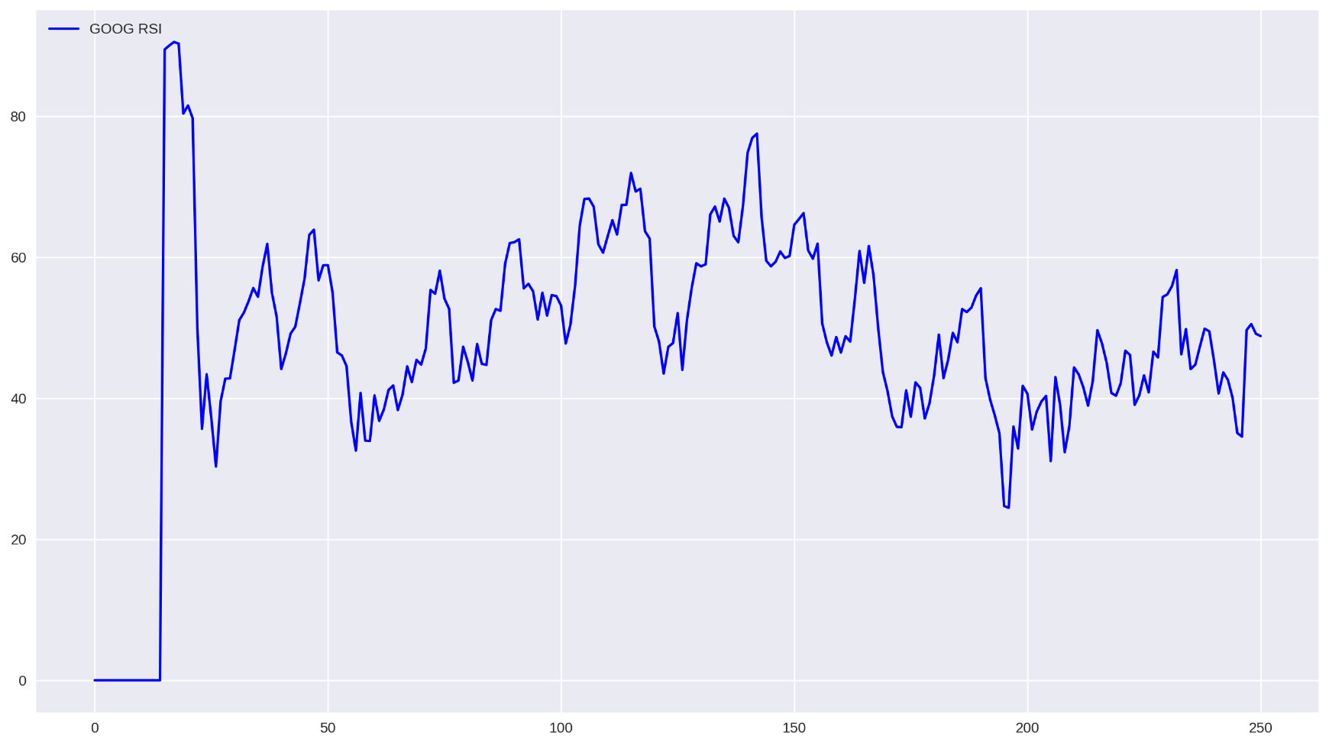
Momentum Indicator Relative Strength Index (RSI)
Used to confirm the presence of overbought and oversold conditions
100
Overbought
RSI = 100 −
1+𝑅𝑆
_{where 𝑅𝑆 =} 𝐴𝑣𝑒𝑟𝑎𝑔𝑒 𝑔𝑎𝑖𝑛 𝑜𝑣𝑒𝑟 𝑎 𝑐ℎ𝑜𝑠𝑒𝑛 𝑡𝑖𝑚𝑒 𝑝𝑒𝑟𝑖𝑜𝑑
𝐴𝑣𝑒𝑟𝑎𝑔𝑒 𝑙𝑜𝑠𝑠 𝑜𝑣𝑒𝑟 𝑎 𝑐ℎ𝑜𝑠𝑒𝑛 𝑡𝑖𝑚𝑒 𝑝𝑒𝑟𝑖𝑜𝑑
Ranges from 0 to 100
<30: Oversold; price too low, more likely to increase
>70: Overbought; price too high, more likely to decrease
RSI is normally computed for
14-Day period
Oversold

Slide 10

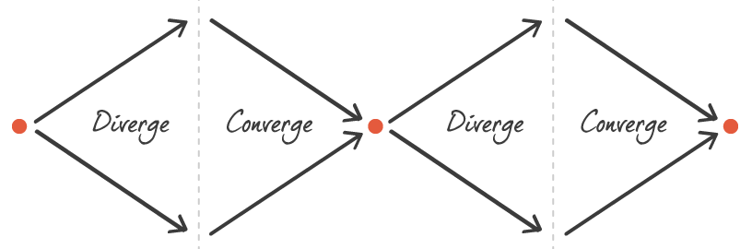
Moving Average Convergence Divergence (MACD)
Is a trend-following momentum indicator that shows the relationship between two moving averages of a security’s price.
A 9-Day EMA of the MACD line called “Signal line” is then plotted on top of the MACD line, which can function as a trigger for buy and sell signals.
Divergence : Two averages if diverging from one another mark the end of a trend
Convergence : Two averages cross over one another this indicates a buy or sell signal

Slide 11
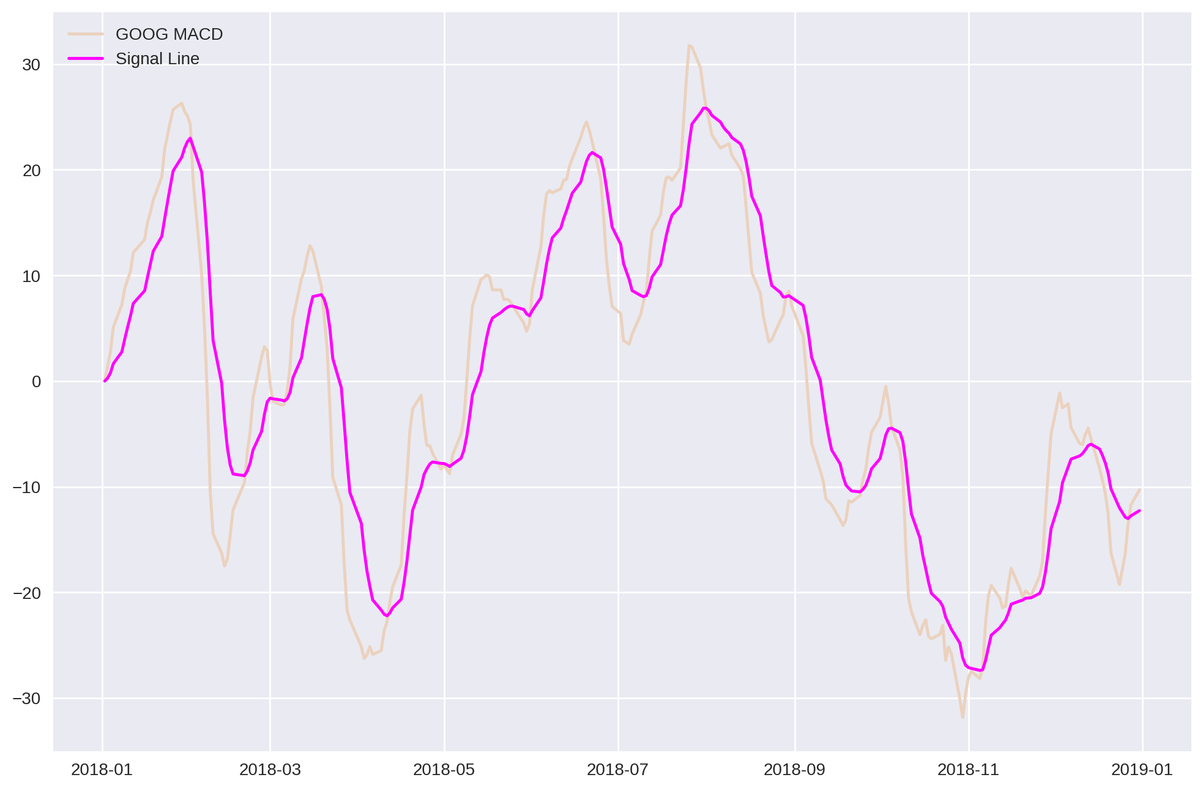
Moving Average Convergence Divergence (MACD)
Signals
•Golden Cross (Buy):
Short EMA > Long EMA
(MACD above Signal line)
•Death Cross (Sell):
Long EMA > Short EMA
(MACD below Signal line)

Slide 12
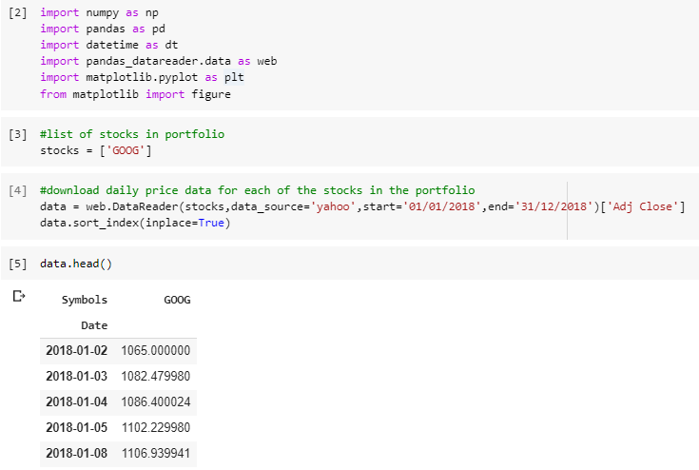
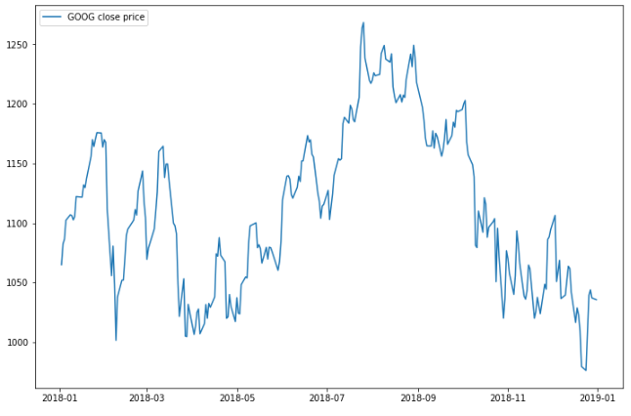
Technical Analysis Implementation
Chosen Stock is GOOG from 1/1/2018 to 1/1/2019
Sideways
Resistance
Support
Downtrend
Uptrend

Slide 13
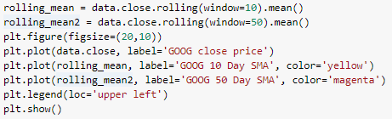
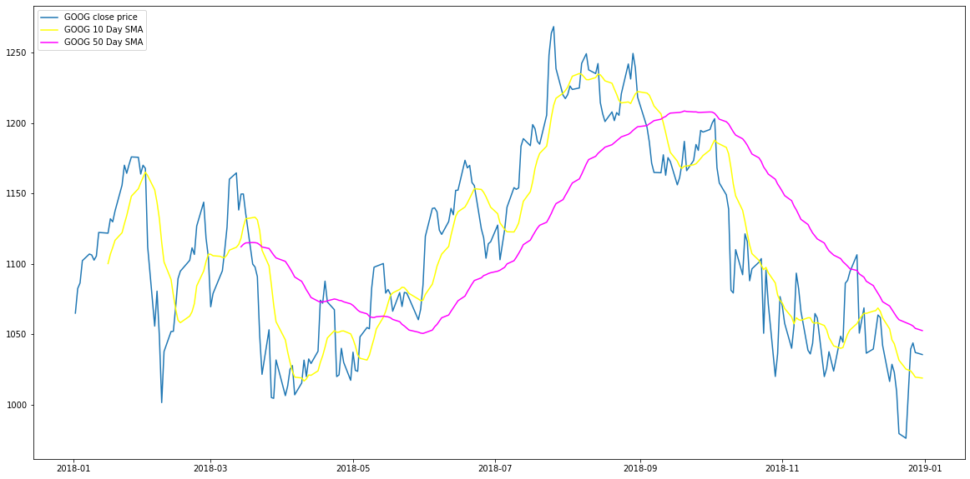
SMA Implementation

Slide 14
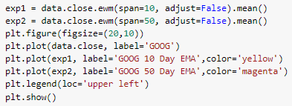
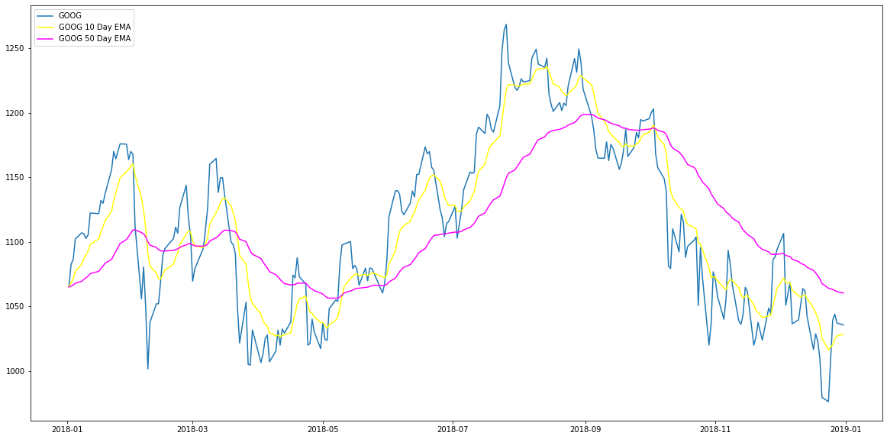
EMA Implementation

Slide 15
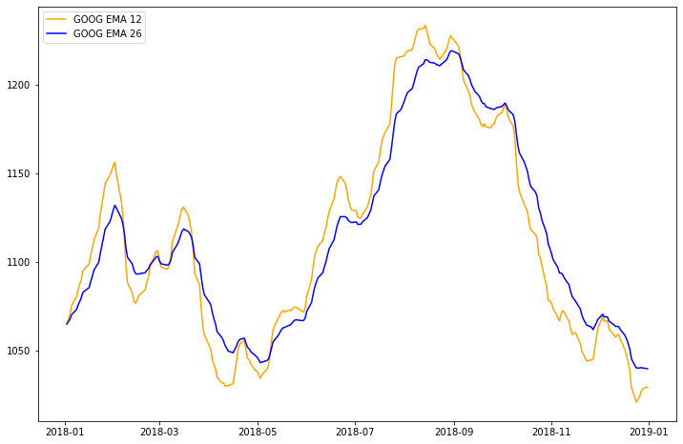
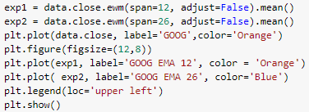
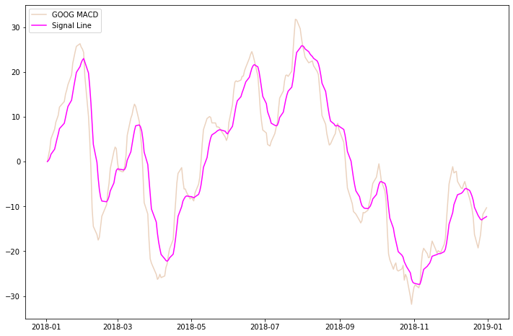
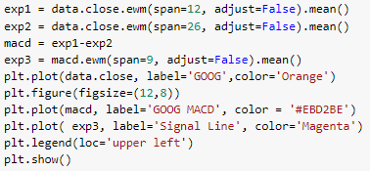
MACD Implementation

Slide 16

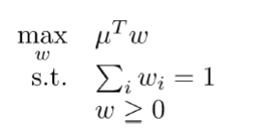
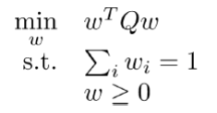
Portfolio Composition
Data: Apple, Google and Tesla Stock Prices from Yahoo Financials 2018 data
Strategy:
1. Maximizing Return
2. Minimizing Volatility
3. Incorporating both i.e. Maximizing Return and Minimizing Volatility

Slide 17
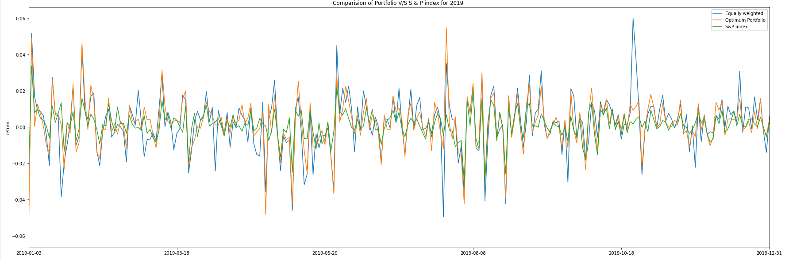
Portfolio Performance 2019
Optimal weights obtained were { ‘AAPL’: 0.44852, ‘GOOG’: 0.50833, ‘TSLA’: 0.04314}
They were used for finding the optimal returns for 2019 data in comparison with S & P Index (SPY) and equally weighted portfolio.
Notes:
If we assign equal weights to all stocks, we can see that even though the returns are high it has very high volatility.
As you can see from the graph for Optimum Portfolio, the returns are higher than S&P Index but the volatility is comparatively high

Slide 18
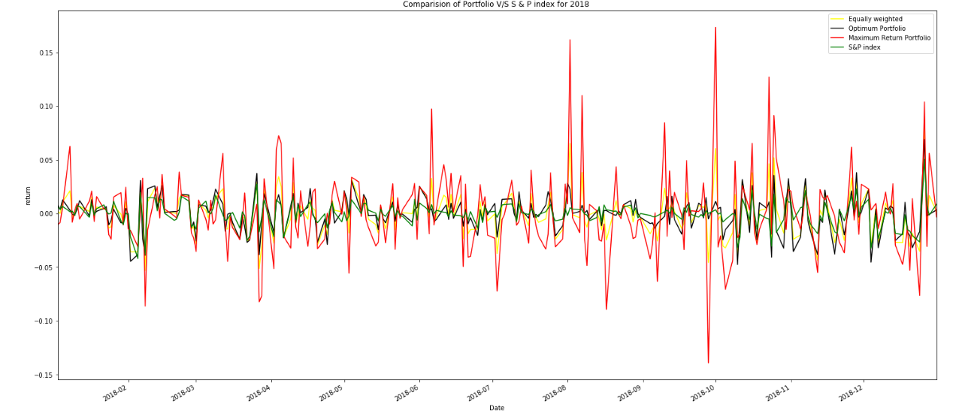
Portfolio Performance 2018
Emphasizing on Maximum Return Portfolio, Returns are relatively very high but it has very high volatility as well.

Slide 19
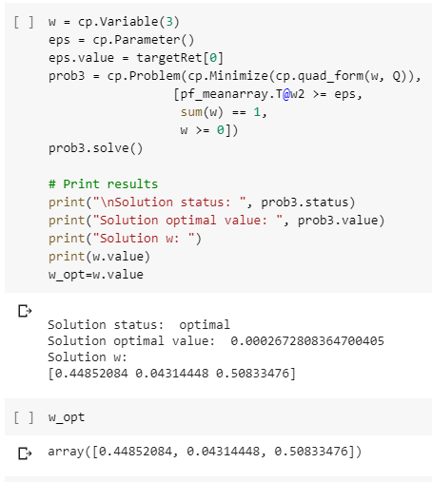
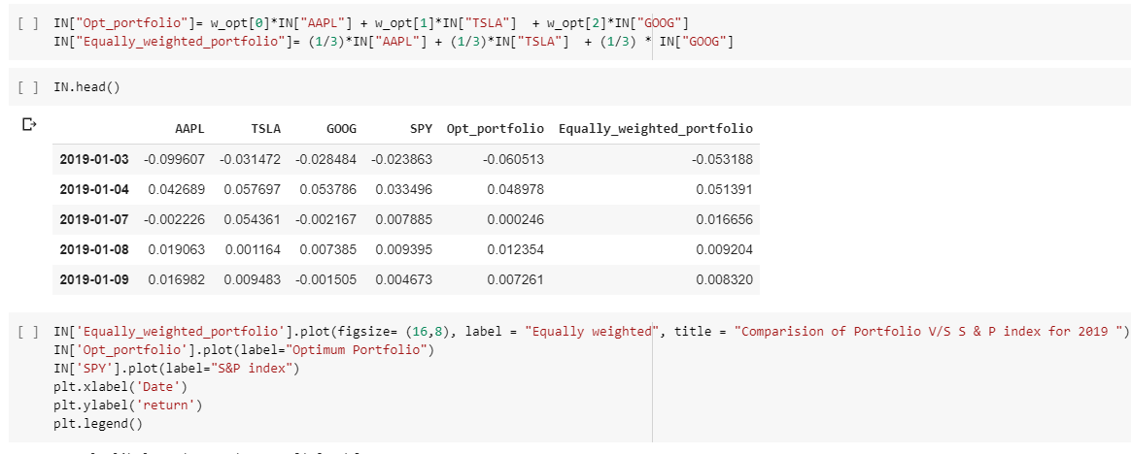
Portfolio Implementation
Using the optimal weights found to find the optimal returns for 2019 data and plotting it against S&P INDEX
MVO- 2018 DATA, OPTIMAL WEIGHTS FOUND

Slide 20
THANK YOU

Slide 21
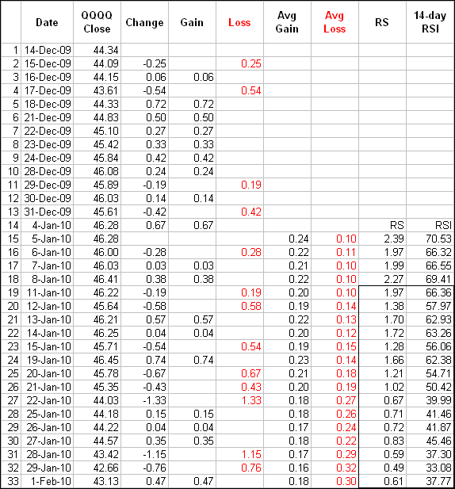
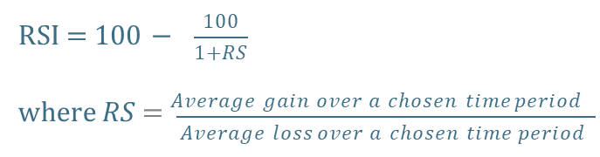
Example of RSI Computation

